Slide 1
Play for All: Inclusive Playful Classrooms
© 2023 President and Fellows of Harvard College. This work is licensed under Creative Commons Attribution-NonCommercial-ShareAlike 4.0 International. Funded by the LEGO Foundation, this resource was developed by Pedagogy of Play at Project Zero.

Slide 2
Gameplan
Learn or revisit definitions of inclusion, dis/ability, and bilingualism.
Through reading, watching video examples, and discussion, build understandings of what playful learning looks like in inclusive classrooms.
In inquiry groups, begin to share documentation with colleagues and use the “Looking Playfully at Documentation” protocol to guide your Playful Participatory Research.

Slide 3
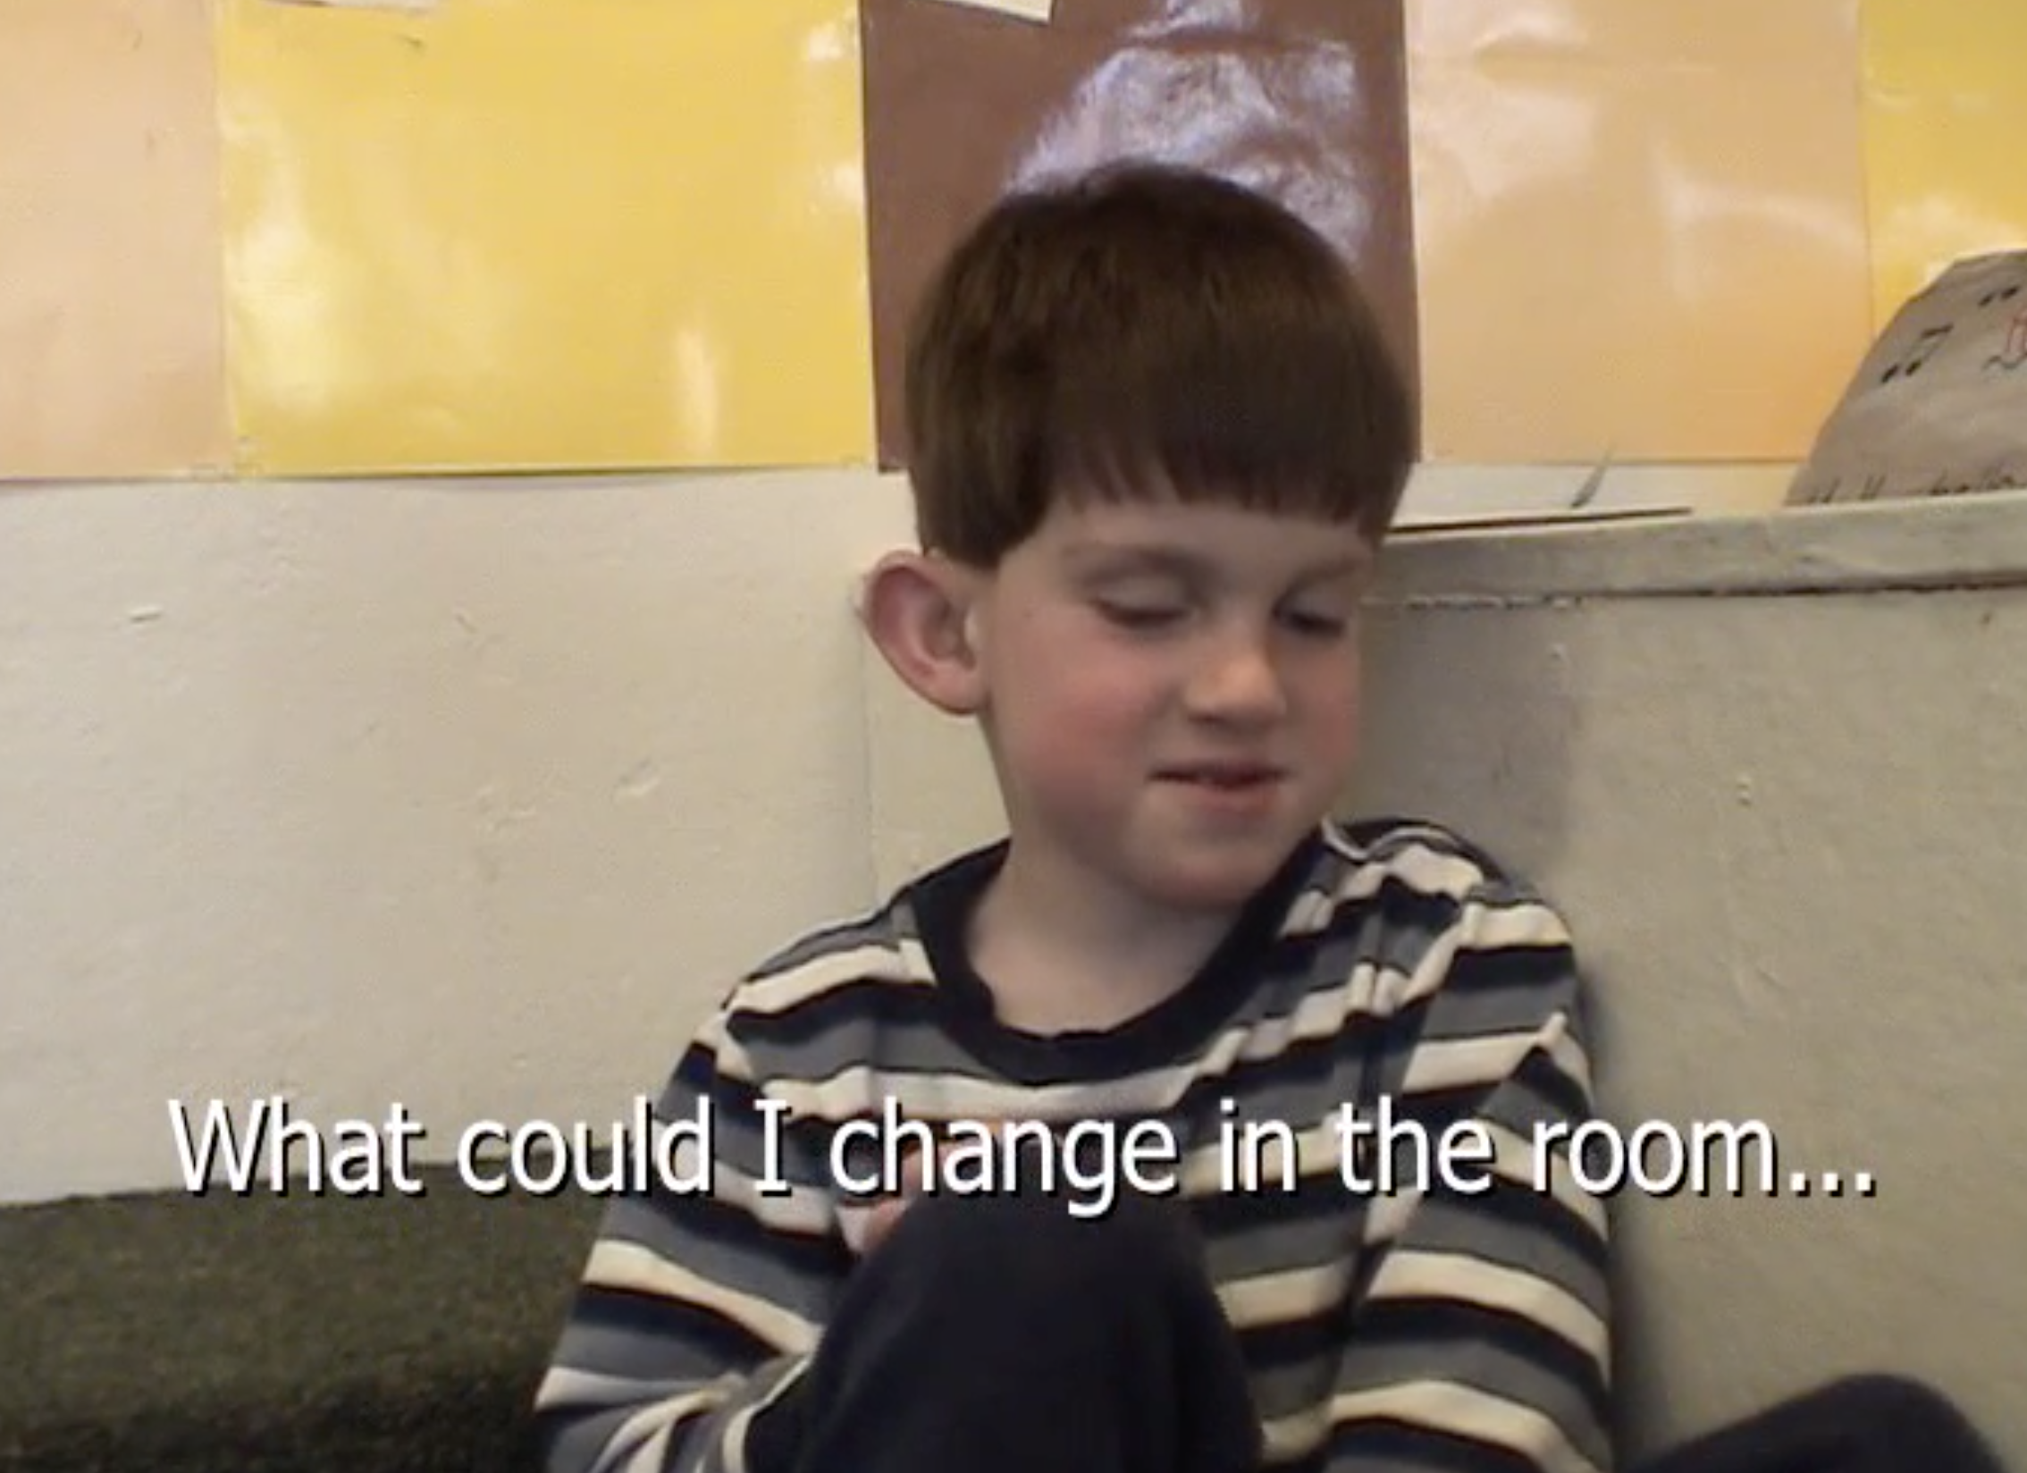
Playful Start
In small groups, use materials in your play kit to represent a scene that demonstrated inclusion from the Power of Aesthetics and Engagement video. Talk about your representation and your initial reactions to the video with your small group.
Link to the video:
https://www.youtube.com/watch?v=0MYz0oFu7D8

Slide 4
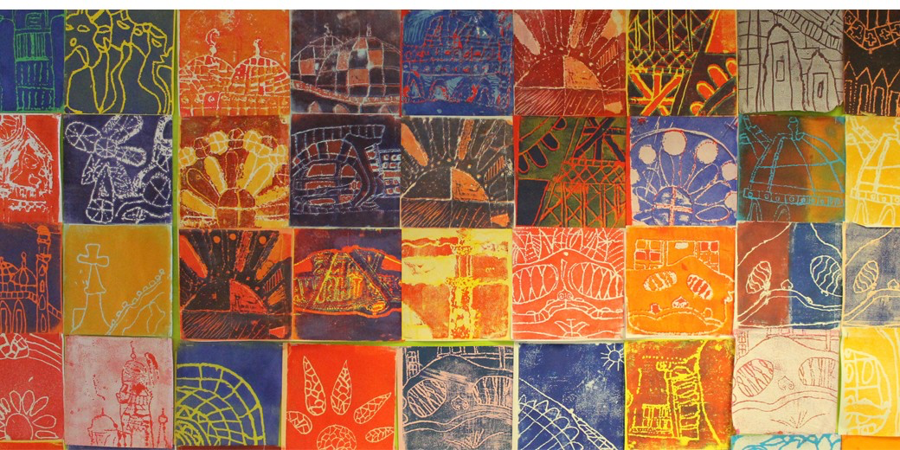
Defining Inclusion
Traditional definition = placement and service of all children, with and without disabilities, in educational settings (Guralnick & Bruder, 2016; DEC/NAEYC, 2009)
Expanded definition = an ongoing process in response to the exclusion of children viewed by educational systems as different (e.g., children with dis/abilities, children of Color, children who are Dual Language Learners) from normative standards (e.g., children who are “typically developing”, children who are White, children whose home language is English)
Notes:
To strengthen children’s participation, social relationships, and learning outcomes (DEC/NAEYC, 2009; U. S. Department of Health and Human Services & U.S. Department of Education, 2015).
Decades of research indicate that inclusion leads to social, cognitive, and academic benefits for young children with and without disabilities (e.g., National Professional Development Center on Inclusion, 2009; Odom, Buysse, & Soukakou, 2011; Gupta, Henninger, & Vinh, 2014).

Slide 5
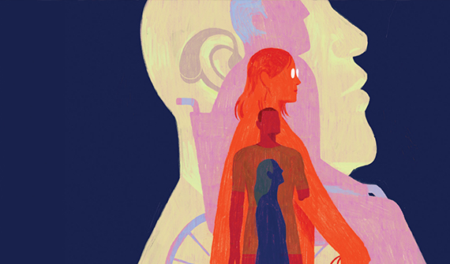
What do we mean by dis/ability?
Image used by permission by Dadu Shin. https://dadushin.com/
Notes:
First, what comes to mind when I use this term? I’ll give you a moment to Turn and talk
Important to be clear about the words I am using and what I mean by them
Disability: Socially constructed identity marker with real consequences.
There may be biological differences (# chromosomes) between us, but the notion of disability is a social responses to those differences – and particularly those definitions of identity that rely on something else being normal
I also use the slash in disability to note how notions of ability get constructed even through our use of language
Folks in the disability community also reclaim this label, which is often perceived through a deficit lens- and share how disability can also be a source if shared identity, solidarity, joy, resistance

Slide 6
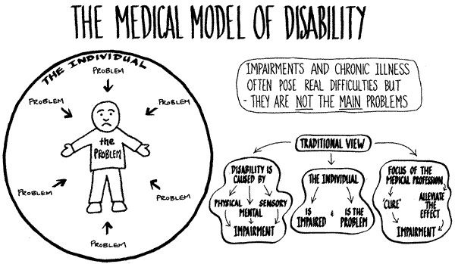
Image used with permission from Thistle Foundation
Notes:
From a medical model perspective, disability is viewed as a biological condition located inside the person.
Through a medical model the person’s impairments, located within them, are viewed as a problem.
This model influences the creation and maintenance of efforts to eliminate disability (e.g., institutionalization, forced sterilization;
From this view the person and their connected problems need remediation and rehabilitation to be cured
Despite strong critiques, this model influences much of our historical and current legal decisions, policy documents, and professional domains

Slide 7
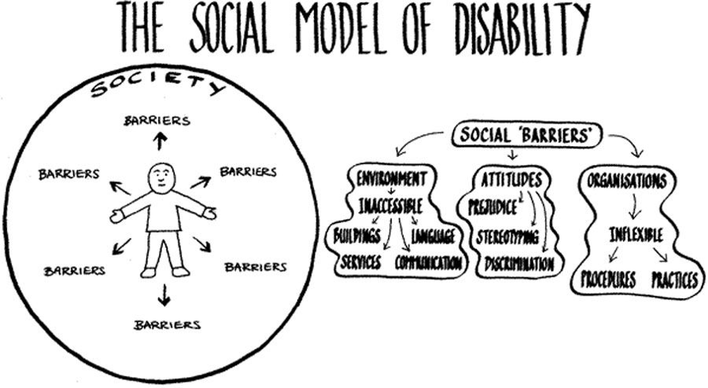
Image used with permission from Thistle Foundation
Notes:
Social model disability is focused on social barriers made by people such as inaccessible environments, unjust attitudes and ideologies, or inflexible organizations
From this view, the person with impairment or chronic illness is not the problem. Instead, societal barriers are the problem
Importantly, from this view, people’s experiences with disability shift depending on social context
Therefore disability is a social/environmental response based on assumptions about normalcy.
The social model of disability focuses on modifying the environment and providing supports to enable people to be successful on their own terms.

Slide 8
What is ableism?
“The devaluation of disability [that] results in societal attitudes that uncritically assert that it is better for a child to walk than roll, speak than sign, read print than read Braille, spell independently than use a spell-check”
(Hehir, 2002, p. 3)
Notes:
Systemic oppression of people with (perceived) disabilities… based on a singular accepted standard of physical, intellectual, and emotional normalcy

Slide 9
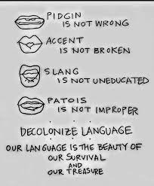
Linguicism
Discrimination of an individual or group based on their use of language
Notes:
Linguicism is discrimination against people based on the languages they speak or do not speak.

Slide 10
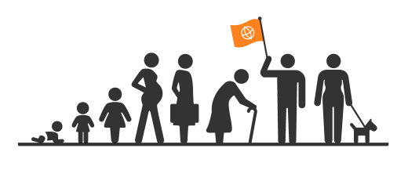
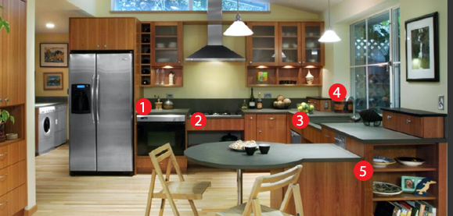
What is Universal Design?
Adapted from the CEEDAR Center http://ceedar.education.ufl.edu/cems/udl/
Notes:
Universal design is a concept which has been growing in popularity since the late 1990s. It is a design philosophy which encourages the design of spaces and product features that are accessible to people of every age and ability. The principals of this design philosophy are a reaction against traditional “handicapped accessible” spaces and adaptive technology, which often limited the functional range of spaces and devices and was almost universally aesthetically unpleasant. Universal design is a ground-up philosophy which uses basic elements to create a world that can be shared by people of all abilities.
UD done well means that accommodations do not have to be made later on.
1. Multiple Counter and Work Station Heights at different heights to accommodate different tasks and postures
2. Low Cooktop with Legroom
3. Shallow Sink with Legroom for Seated User
4. Lever Handle Faucet, Pull-Down Spray
5. Open Shelves and Clear Cabinet Doors

Slide 11
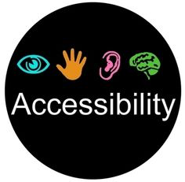
Architecture Education
In schools, UDL (Universal Design for Learning) can be used to fix the classroom environment and curriculum instead of trying to fix the child.
Notes:
UDL can be a useful framework to think about in creating inclusive and playful classrooms.

Slide 12
UDL Guidelines
Provide multiple means of representation for learners to gain information
Provide multiple means of action and expression to enable learners to demonstrate what they know (e.g. singing, action, using materials)
Provide multiple means of engagement to encourage learner’s interests and increase motivation
From Conn-Powers et al., 2006, p.422
Notes:
These guidelines are very consistent with the Pedagogy of Play practices that we will start to discuss next week

Slide 13
The Power of Aesthetics and Engagement – some context
Profile of the class
18 five and six-year-olds
Inclusion model with children with special rights and typically developing children
Special rights included: blindness, hearing impairment, anxiety, autism spectrum, sensory integration, reading difficulties
2 children learning English as an additional language
Inclusion strategies
Braille labels throughout the classroom
Non-visual entry points into lessons
Curriculum planning based on students’ interests and strengthens
Range of seating at whole class meetings and for table activities
Sensory integration materials (e.g. weighted vests, sit-and-move cushions, fidget toys) to support focus
Notes:
You watched a video before class today – let’s discuss and connect back to the ideas of UDL and inclusion

Slide 14
The Power of Aesthetics and Engagement – debriefing the video
What struck you about inclusion in this classroom?
What did the teachers in this classroom do to support inclusive play for all children?
What are you wondering about?
Notes:
You watched a video before class today – let’s discuss and connect back to the ideas of UDL and inclusion

Slide 15
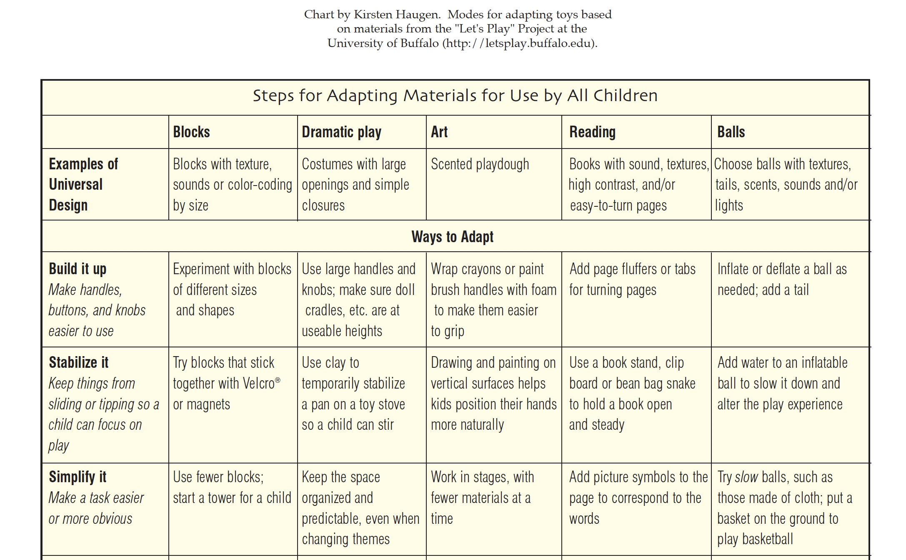
Notes:
Here’s an example about how a UDL perspective can be useful to teachers in preparing the classroom environment for inclusive play in the early years – from the Let’s Play project at the University of Buffalo

Slide 16
Resources on Inclusion and Play:
Add your list here of resources you’ve asked your students to read/watch/listen to before this class
Include 3-5 options and invite students to choose among them, so students will come to class having read different things
Notes:
Everyone chose something to read/watch for today – one of these. We are going to do an activity now where you will have a chance to share and discuss what you read about with others.

Slide 17
Let’s Play: Give One, Get One, Let’s Pretend

Slide 18
Let’s Play: Give One, Get One, Let’s Pretend
1) Prepare:
Fold a piece of paper into 4 sections
In one section – write down one strategy/ approach/ consideration for tailoring play experiences for DLLs or children with dis/abilities that you learned from the articles/resource you read or watched before class
Leave the other sections blank
2) Pair:
Give one: give brief context about the article and share one of the ideas you have. E.g. “I read the article about bilingual learners, and one strategy they mentioned was… “
Get one: listen as your partner shares their article/strategy
Let’s pretend: imagine your future context working with children. How might you implement that strategy?
Notes:
Talk through these instructions

Slide 19
Whole Group Discussion
What surprised you?
What are you still wondering?

Slide 20
Looking Playfully at Documentation Protocol
Listening: The presenting teacher names their question and gives context about the documentation they are sharing (2 min)
Looking: Look carefully at the documentation for a few minutes (2-3 min)
Clarifying: Presenter answers short, fact-based questions from the group (2 min)
Noticing and Wondering: a round of “I notice” (just saying what you see/hear in the documentation without judgement), and then ”I wonder” statements. The presenter listens and is silent (4 min)
Pretending: Take on roles, act out a scenario from the documentation (2-3 min)
Noticing/Wondering again: Did the playing help you notice anything new? (2 min)
Inspiring: Repeat the presenter’s question. What could the presenter try as next steps in their teaching? Or share ideas of what to document next. (5 min)
Closing: The presenter has the last word to share their take-aways/questions. (2 min)
Notes:
This is a protocol to use for sharing documentation in the inquiry groups. Will use this for the rest of the semester

Slide 21
Looking Playfully at Documentation Protocol
20 min

Slide 22
Listening (2 min)
Listen as the person bringing the documentation shares context
State the question that guided gathering this documentation (your PPR research question)
Briefly explain the context – where/when was this documentation gathered?

Slide 23
Looking (3 min)
Silently view the documentation

Slide 24
Clarifying (2 min)
Presenter answers short, fact-based questions from the group

Slide 25
Noticing and Wondering (4 min)
Restate the documenter’s question
A round of “I notice…” “I see…” and “I wonder…?” comments.
The presenter is silent and we talk about them in the 3rd person

Slide 26
Pretending (2 min)
Take on roles and act out the scenario captured in the documentation

Slide 27
Noticing/Wondering again (2 min)
Did the acting help you to notice or wonder anything new?
A round of “I notice…” “I see…” and “I wonder…?” comments. The presenter is silent.

Slide 28
Inspiring (4 min)
Remember the presenter’s research question
Make suggestions that the presenter could try as next steps in her practice or documentation to keep learning more about their question
Share ways that you were inspired by this work

Slide 29
Closing (2 min)
The presenter has the last word – what struck you in this exploration of the documentation? What are you thinking about now?

