Slide 1
Frameworks and Theories to Understand Play
© 2023 President and Fellows of Harvard College. This work is licensed under Creative Commons Attribution-NonCommercial-ShareAlike 4.0 International. Funded by the LEGO Foundation, this resource was developed by Pedagogy of Play at Project Zero.

Slide 2
Agenda
Playful start
Neurology and play – whole group discussion
Break
Play Theories: The Gameshow
Stars and Wishes

Slide 3
Playful Start
Choose either Replay or Figure Me Out Identity Web – see instructor guide

Slide 4
Play Kit
Something to sculpt with (clay, putty, slime, playdough)
Something to build/construct with (LEGOs, blocks, popsicle sticks, plastic cups, rocks, sticks)
A collection of Beautiful Stuff
Paper and something to make marks with (markers, crayons, paints, pastels)

Slide 5
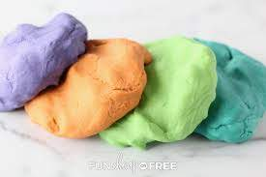
Playdough Recipe
1 c flour
1/3 c salt
1 c boiling water
1 Tbsp cream of tartar*
1 Tbsp oil
Food coloring if you wish
Mix the flour, salt, and cream of tartar
Mix together the boiling water, oil, and food coloring
Combine everything until mixed, then knead with your hands until smooth
Add a little more flour if too sticky
Store in an airtight container at room temperature
*if you don’t have cream of tartar, you can skip this and just keep your playdough in the fridge. It won’t keep as long but will work ok

Slide 6
Frameworks and Theories to Understand Play

Slide 7
What is play?

Slide 8
“Remembering what play is all about and making it part of our daily lives are probably the most important factors in being a fulfilled human being. The ability to play is critical not only to being happy, but also to sustaining social relationships and being a creative, innovative person.
Brown, S. & Vaughan, C. (2009)

Slide 9
What is play? I hate to say…
Apparently purposeless (done for it’s own sake, not for survival)
Voluntary
Inherent attraction
Freedom from time (sense of flow)
Diminished consciousness of self
Improvisational potential
Continuation desire
From Brown & Vaughan, 2009
Notes:
Here’s a definition of what play is from Brown & Vaughan – play researchers

Slide 10
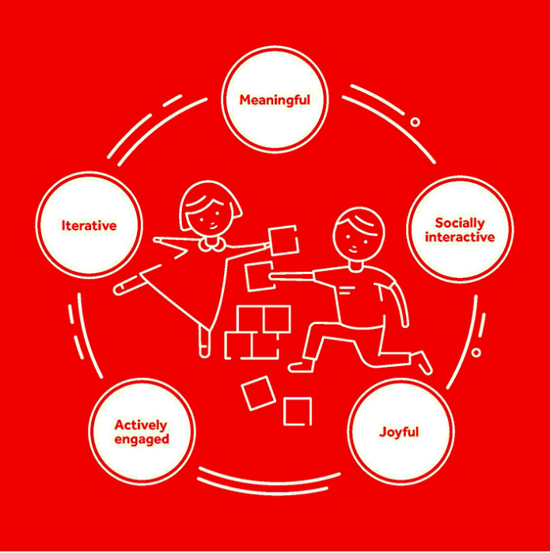
(LEGO Foundation, 2017)
Notes:
These are the LEGO 5 play characteristics – another way to define what play means

Slide 11
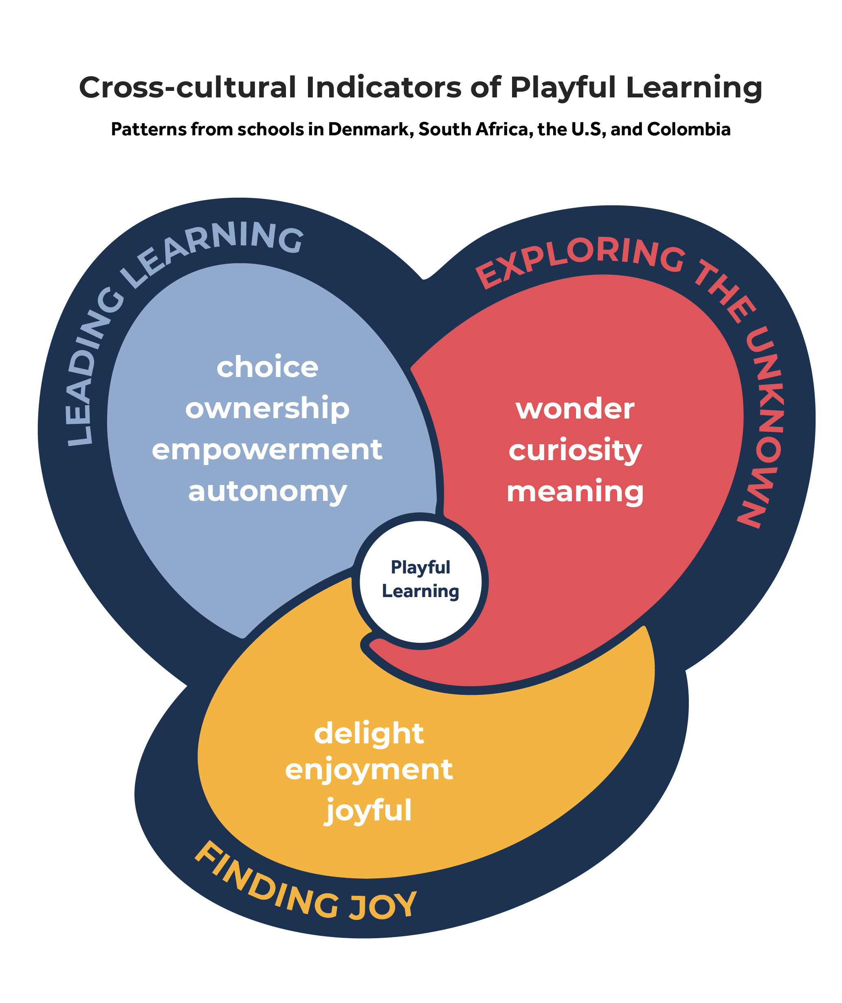
Notes:
These are the Pedagogy of Play cross-cultural indicators of playful learning. This model of what learning through play looks like and feels like in schools is based on research across four cultural contexts: 1 school in Denmark, 3 schools in South Africa, 6 schools in the U.S., and 5 schools in Colombia.

Slide 12
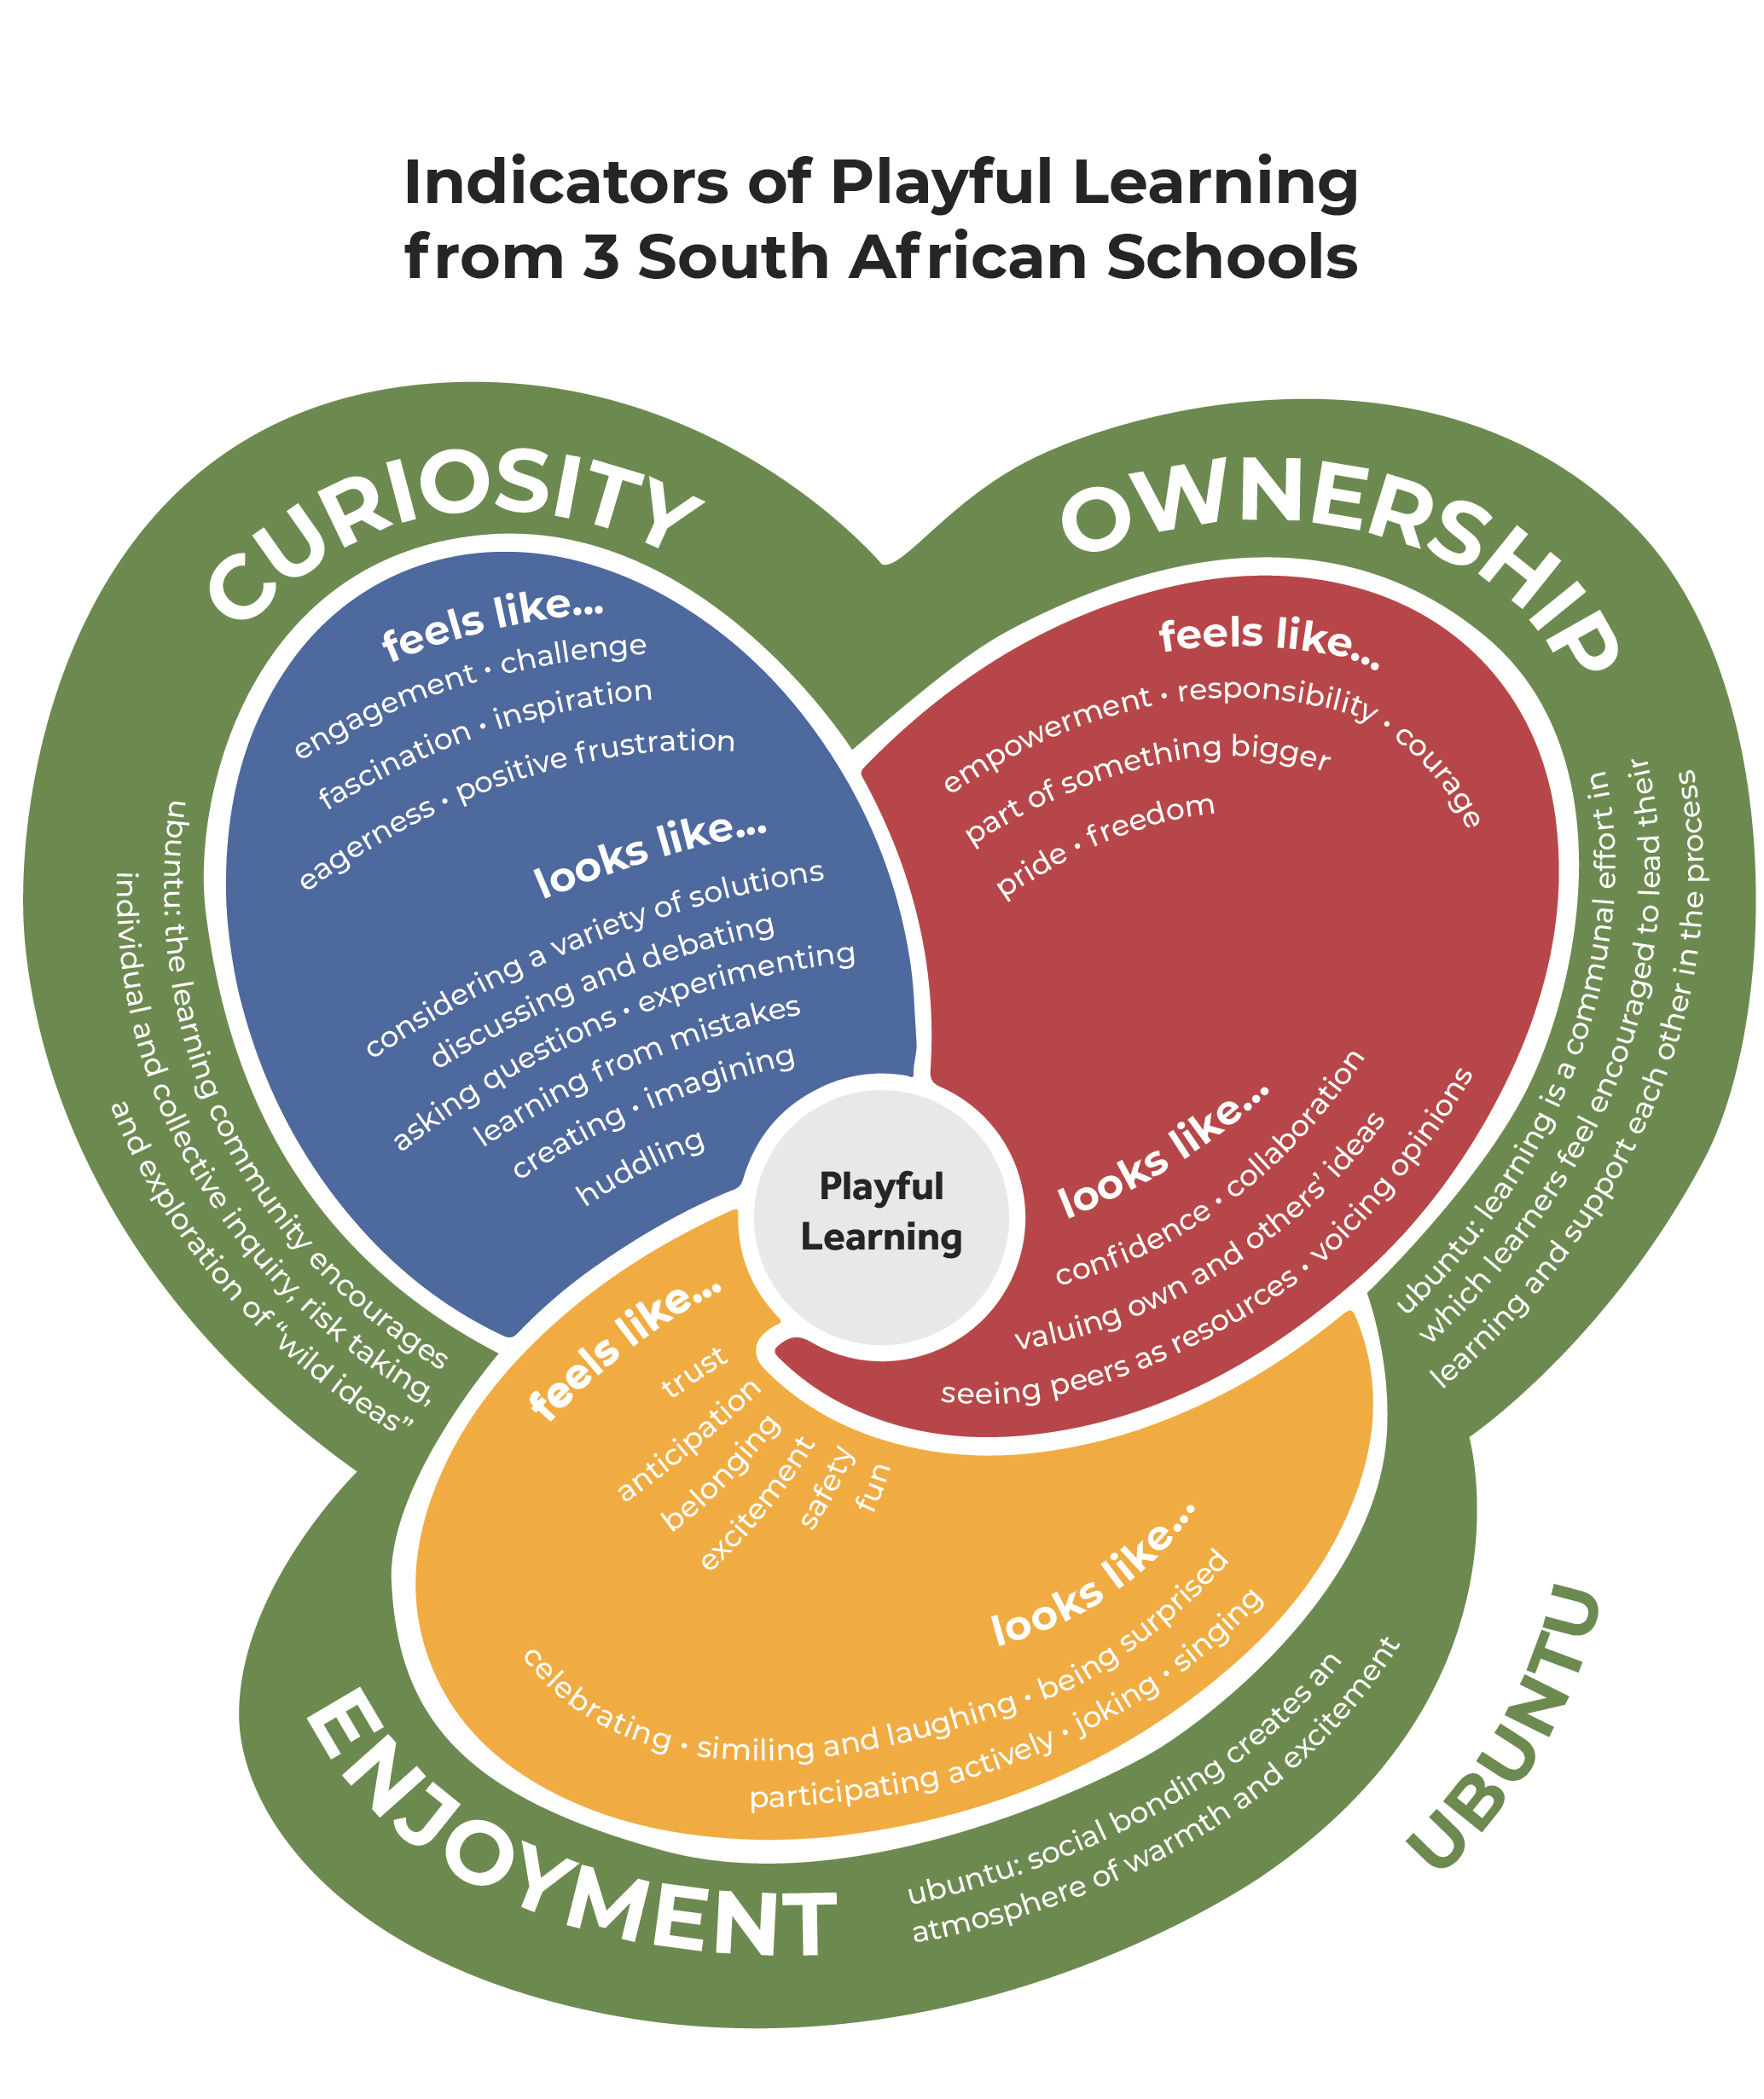
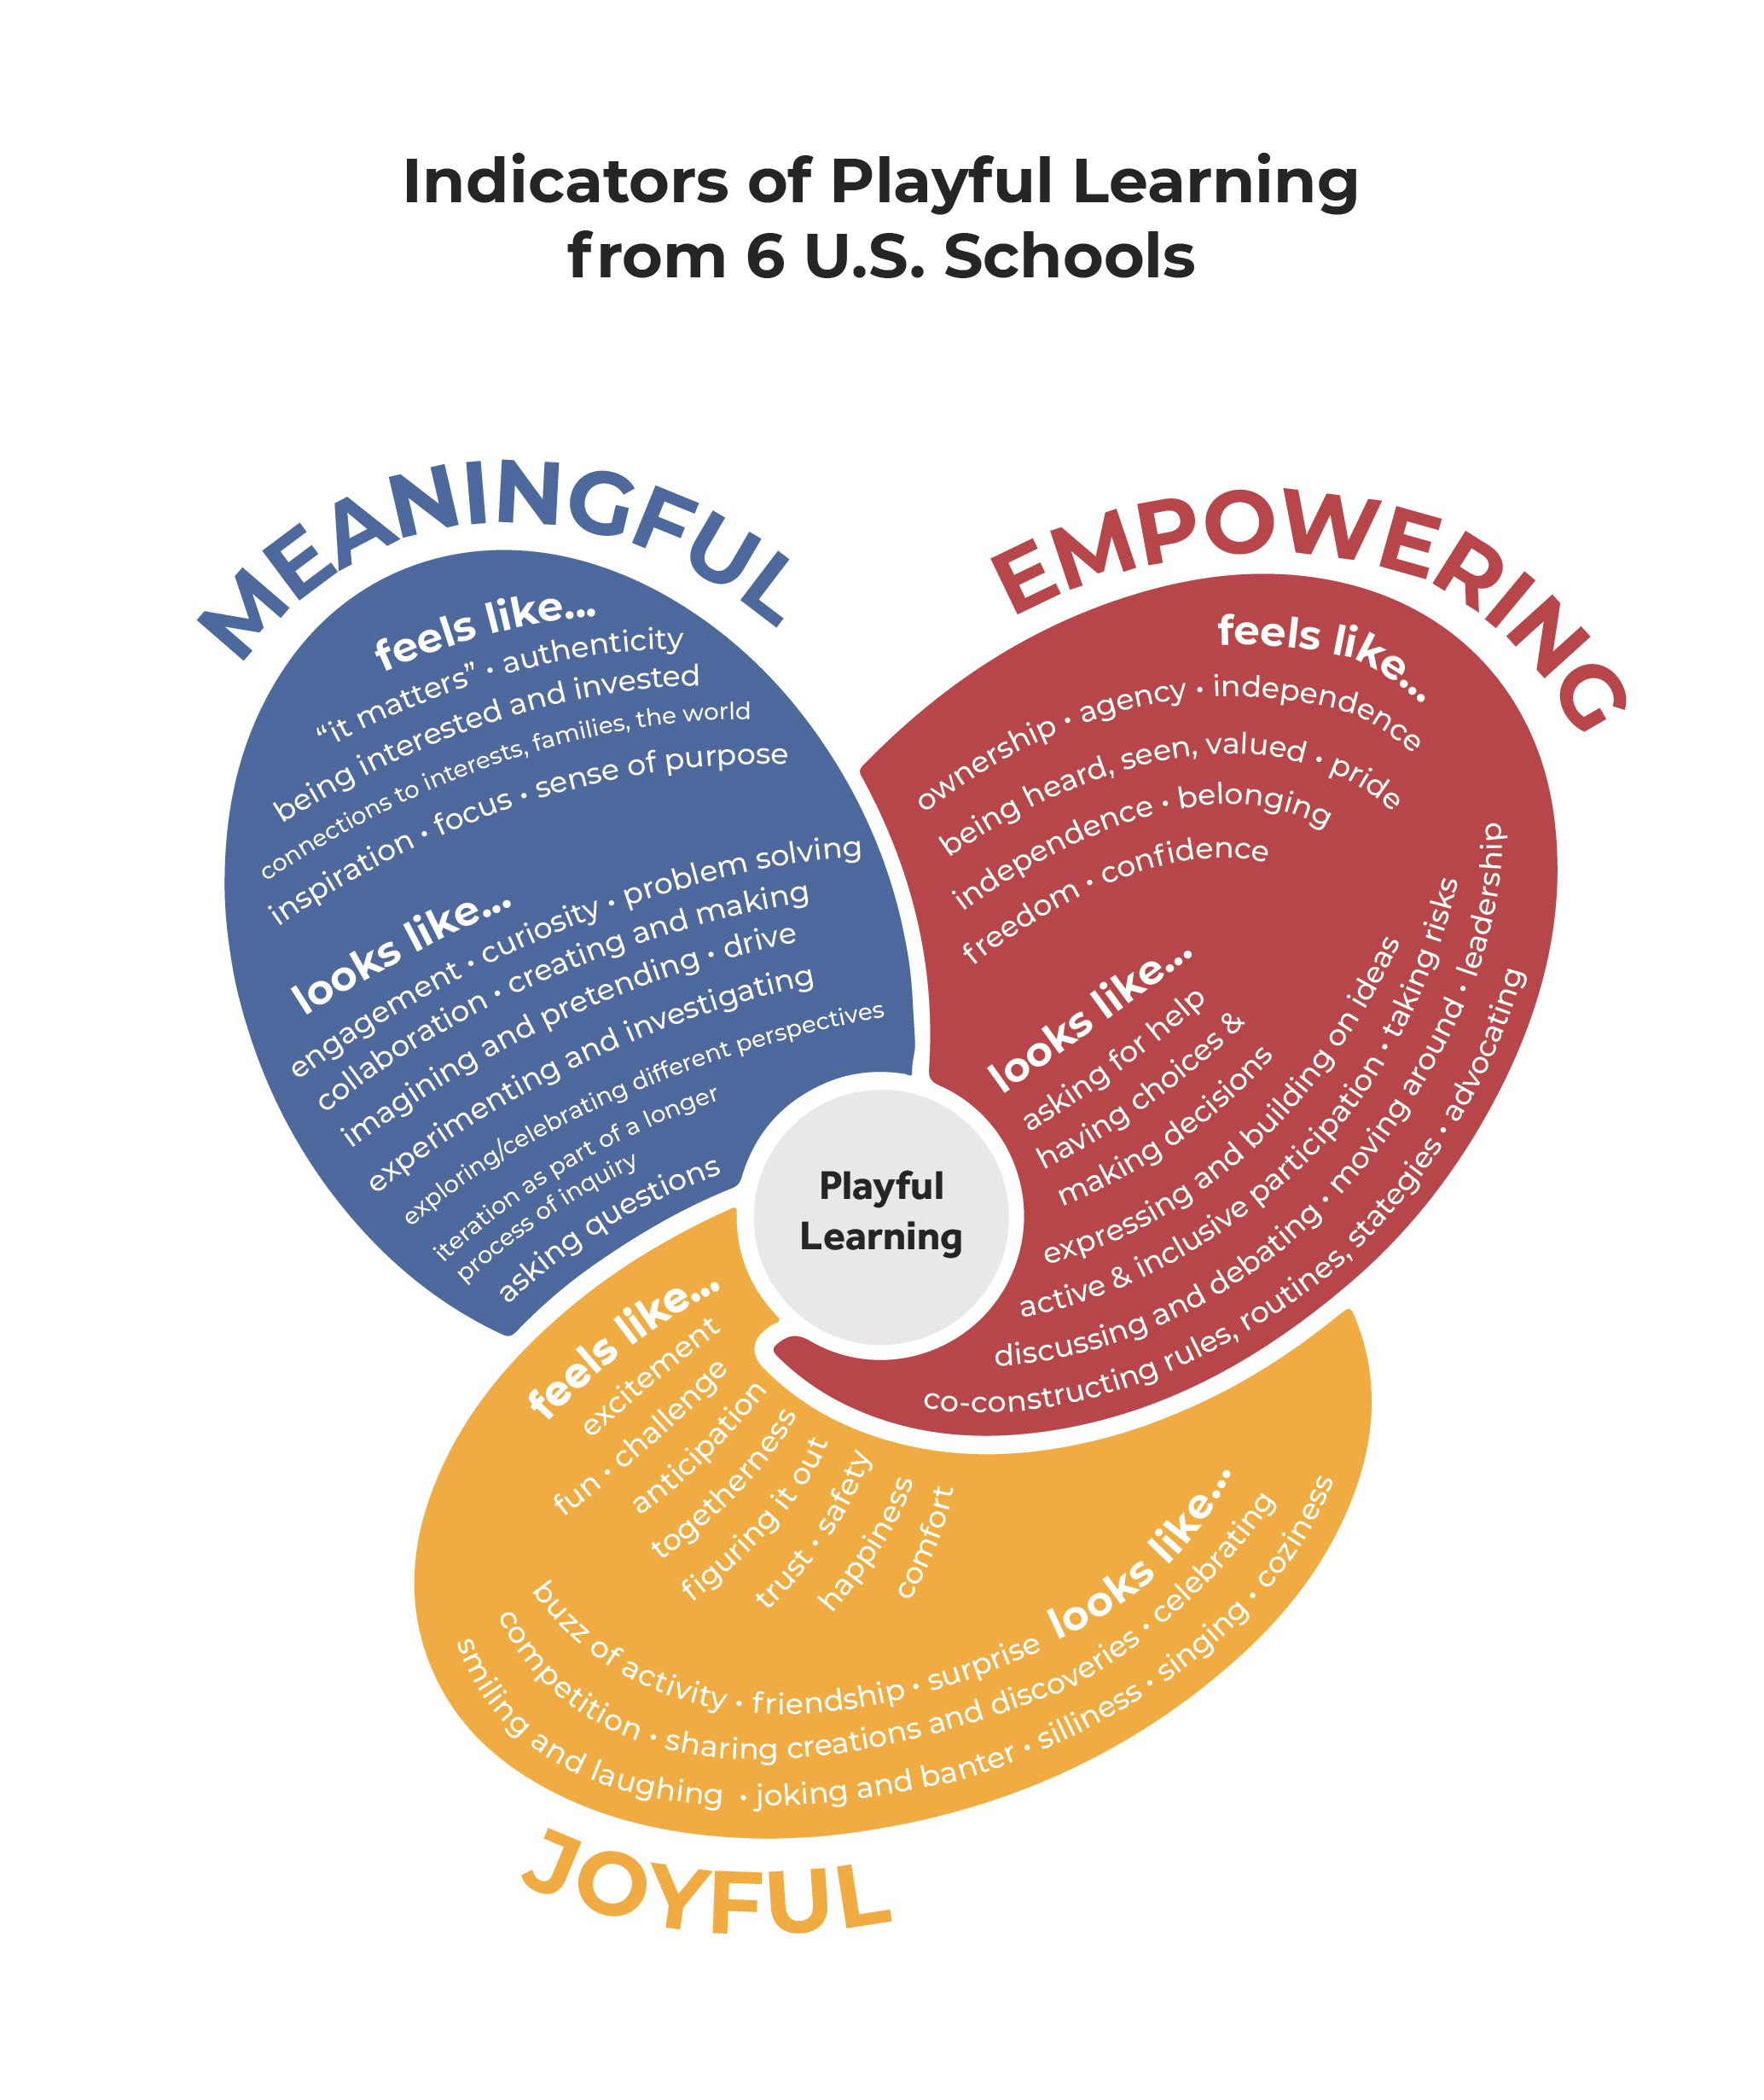
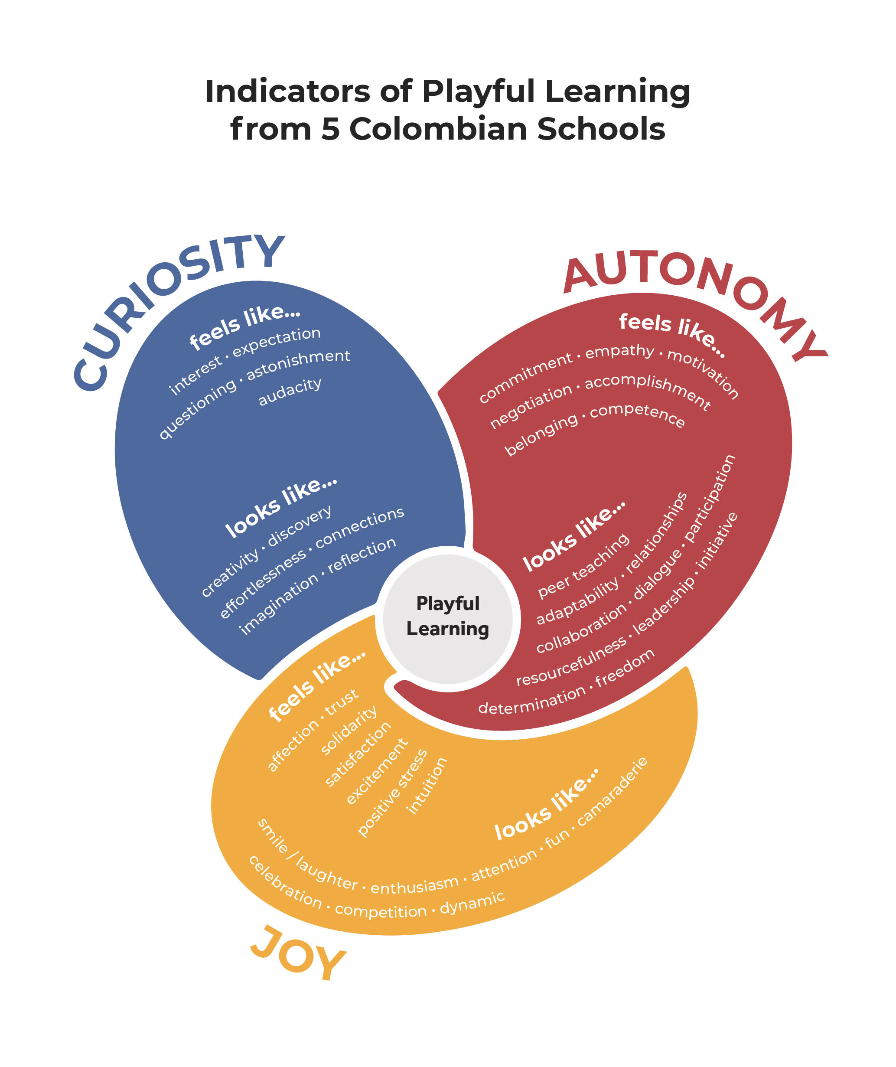
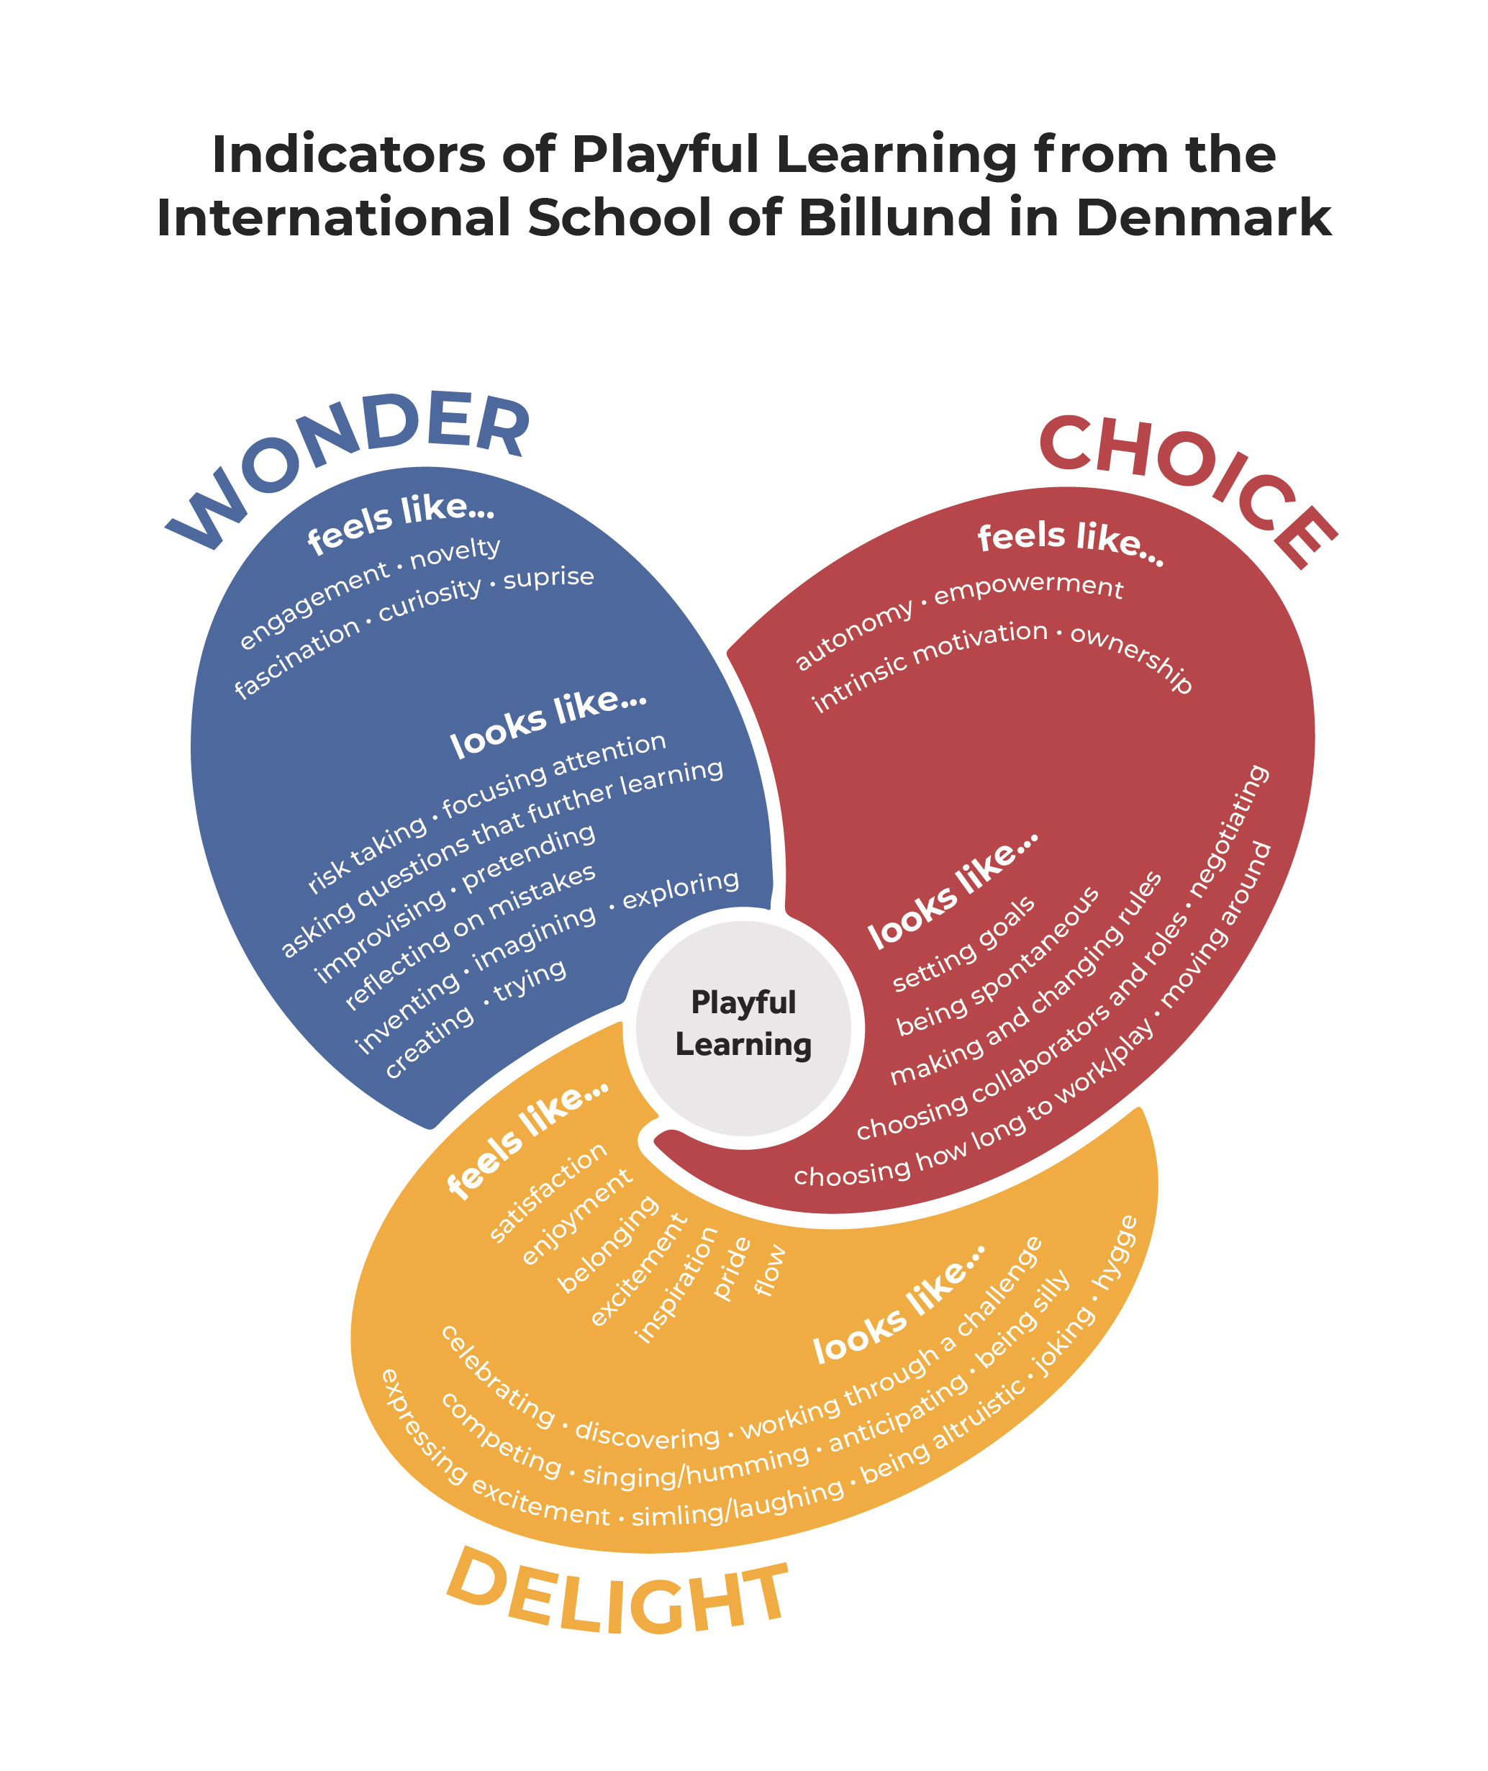
Indicators of Playful Learning
Ownership
Curiosity
Playful
Learning
Enjoyment
Empowering
Meaningful
Playful
Learning
Joyful
Notes:
Here are the individual versions from each of those cultural contexts. This is the way the PoP research is working on defining learning through play in schools. We will learn lots more about these Indicators of Playful Learning later in the course

Slide 13
Types of play
Fantasy/imaginative play
Constructive play
Games with rules
Rough-and-tumble play
Taboo play
Now think about your play autobiography – what type of play were you engaged in?
Notes:
If you assigned the Mraz et al. reading, these types of play are discussed there

Slide 14
Stages of play (Parten, 1932)
Unoccupied behavior
Onlooker behavior
Solitary play
Parallel play
Associative play
Cooperative play
Notes:
Also discussed in the Mraz chapter

Slide 15
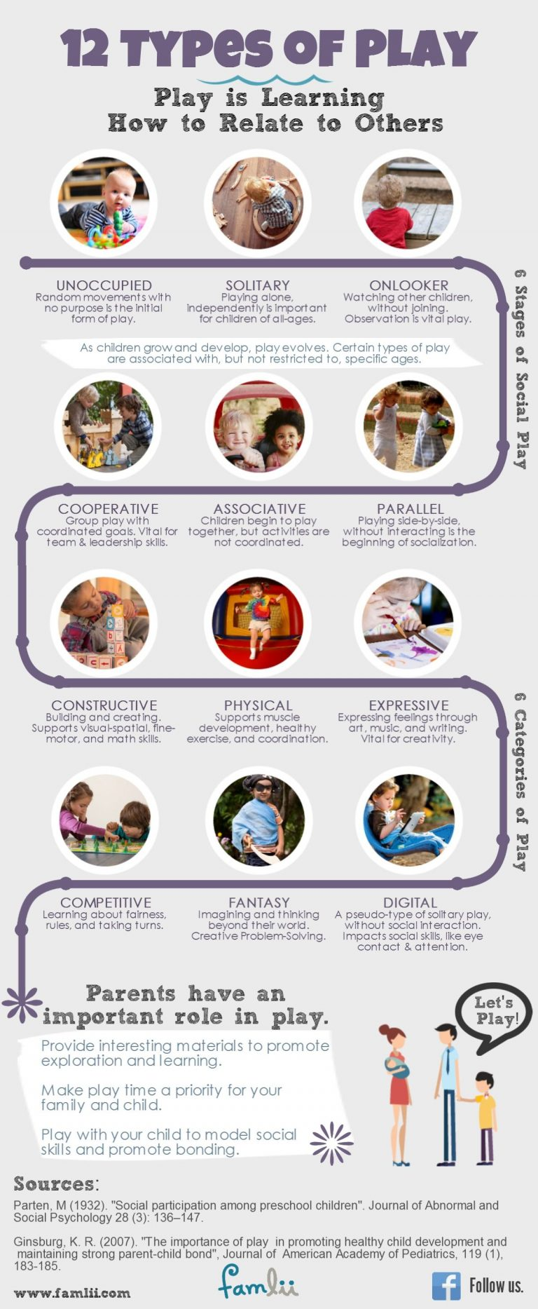
Notes:
This is a helpful infographic that helps to get a quick overview of some of the most widely used ways of categorizing play

Slide 16
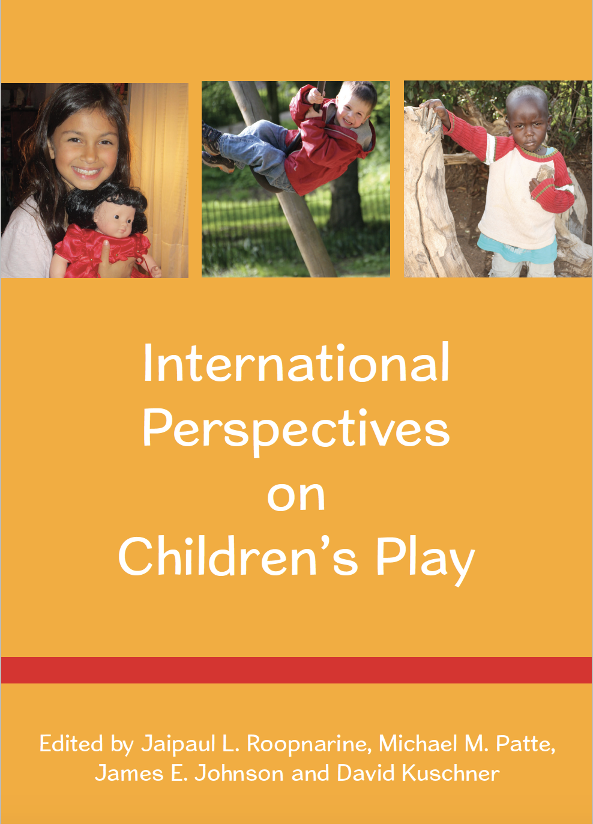

Slide 17
“Traditionally, play has been conceptualized within a narrow band of theories on cognitive and social development (e.g., Piaget’s cognitive developmental theory; Parten’s play typologies) that were presumed to have universal applications. More recent conceptualizations of childhood development in the areas of cultural psychology and early education (e.g., Greenfield et al. 2003; Chaudhary and Tuli 2010) have proposed different cultural pathways to achieve common developmental goals across cultures…In most cases, the theoretical perspectives converge or intersect regarding play as a universal cultural activity. However, they do diverge on the developmental significance of play. Its benefits for the development of cognitive and social skills in children in different cultural settings are only now beginning to be discerned…Whereas, in some cultural communities, a strong case is made for the connection between play activities and practicing and learning culture-specific modes of behaviors, in others, children learn through a mixture of work and play or by observing others and replicating their activities.”
(Roopnarine et al., 2015, p.2)

Slide 18
What happens in the brain during play?

Slide 19
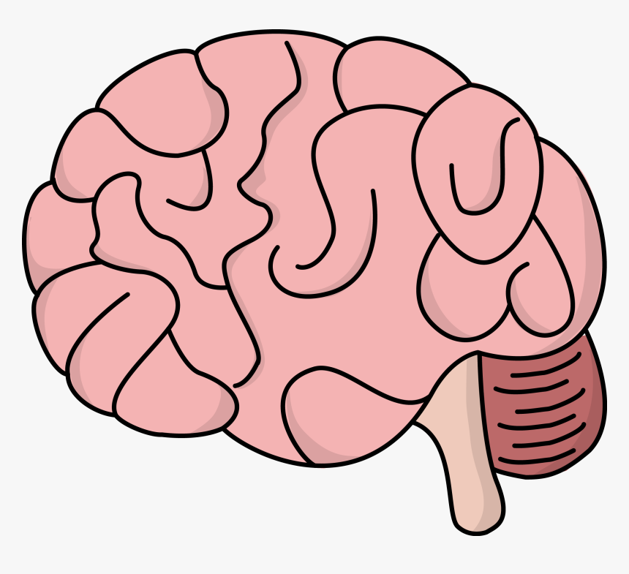
Your Brain

Slide 20
Your Brain on Play

Slide 21
Your Brain on Play

Slide 22
Notes:
Key takeaways from the Liu et al. neuroscience report – talk through how significant these brain impacts are.

Slide 23
Play gives access to content and higher levels of thinking for a variety of learners.
-Mraz, Porcelli, & Tyler (2016)

Slide 24
Play and Neuroscience Discussion
What stood out to you in the neuroscience and play report?
What are you curious about?
Two ways to participate:
Please raise your hand to speak, or add comments/questions to the chat

Slide 25
Extra resource
http://playtime.pem.org/play-digest-this-is-your-brain-on-play/

Slide 26
Theories for Understanding Play

Slide 27
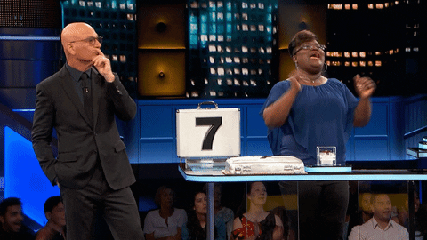
Play Theories: The Gameshow

Slide 28
Playing the Gameshow
Teams take turns being Play Analysts or Judges.
Play Analysts: Work with your team to come up with the most convincing in-character analysis of the play episode. You have 90 sec to prepare each round. Share your response (in character, of course).
Bonus point in each round for correctly identifying the type of play (see Mraz et al. Chapter 2)
Second bonus point for making a substantive connection to the the neurology report
Judges: award a point to the team with the most theoretically sound and in-character response.
Winning the game: The team with the most points at the end of the game wins fame and fortune (or at least a fun applause of their choice)

Slide 29
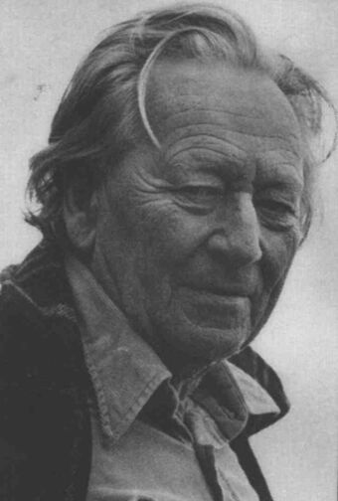
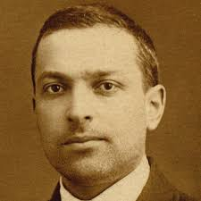
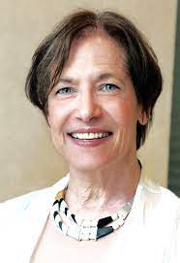
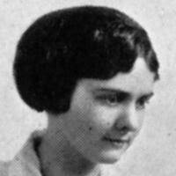
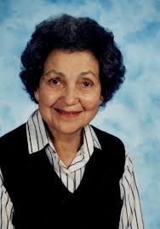
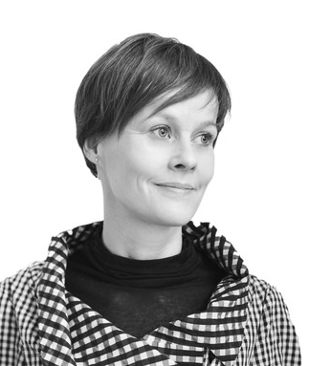
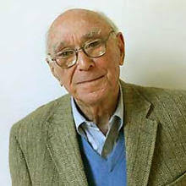
Pick your Team!
Team Vygotsky
Team Piaget
Team Bateson
Team Corsaro
Team Bruner
Team Parten
Team Paley
Team Bruce
Team Skovbjerg
Team Hirsh-Pasek
Notes:
Bateson – play frames
What roles are children taking on? Is there role flexibility at play?
Do the events in the play frame relate to their real world? How?
Vygotsky – play as a ZPD
What pivots (play objects) are involved?
In what ways do adults scaffold play?
How is play socially constructed?
Piaget – play as assimilation
How are children acting on objects to assimilate knowledge?
Are children transforming objects or themselves during play?
Bruner – problem solving (Frost p.40)
What domains of learning are children developing in this play?
Are children acting in ways that minimize consequences, compared to actions in the real world?
Are tools being used to solve problems?
Corsaro - peer culture and play talk (Frost p.45 table)
What types of play talk took place in this play episode?
What do you think about the social dynamics/power relationships here?
Paley – storytelling, culture, and language development
What stories are children telling during their play?
As a teacher researcher, what are you learning about these children by observing their play?

Slide 30
Corsaro - peer culture and play talk
What types of play talk took place in this play episode?
What do you think about the social dynamics/power relationships here?
Paley – storytelling, culture, and language development
What stories are children telling during their play?
As a teacher researcher, what are you learning about these children by observing their play?
Bruce – 12 features of play
What features of play do you see in this example?
Skovbjerg – play moods
What play moods do you observe in this example?
Hirsh-Pasek – guided play
In what ways are educators guiding play in this example?
Bateson – play frames
What roles are children taking on? Is there role flexibility at play?
Do the events in the play frame relate to their real world? How?
Vygotsky – play as a ZPD
What pivots (play objects) are involved?
In what ways do adults scaffold play?
How is play socially constructed?
Piaget – play as assimilation
How are children acting on objects to assimilate knowledge?
Are children transforming objects or themselves during play?
Bruner – problem solving
What domains of learning are children developing in this play?
Are children acting in ways that minimize consequences, compared to actions in the real world?
Are tools being used to solve problems?

Slide 31
Round 1
Team Bruner
Team Parten
Team Vygotsky
Team Bruce

Slide 32
Insert video link to video library clip of your choice here

Slide 33
Round 2
Team Corsaro
Team Paley
Team Bateson
Team Hirsh-Pasek

Slide 34
Insert video link to video library clip of your choice here

Slide 35
Round 3
Team Parten
Team Piaget
Team Skovbjerg
Team Bruce

Slide 36
Insert video link to video library clip of your choice here

Slide 37
Round 4
Team Paley
Team Piaget
Team Vygotsky
Team Hirsh-Pasek

Slide 38
Insert video link to video library clip of your choice here

Slide 39
Round 5
Team Bateson
Team Corsaro
Team Bruner
Team Skovbjerg

Slide 40
Insert video link to video library clip of your choice here

Slide 41
“Remember that theory should help you think about and understand what you are seeing children do, and that no one theory will explain it all.” Frost (2012) p.53

Slide 42
Star and Wish
Add link here if you choose to do star/wish reflections digitally

