Slide 1
Equity and Play
© 2023 President and Fellows of Harvard College. This work is licensed under Creative Commons Attribution-NonCommercial-ShareAlike 4.0 International. Funded by the LEGO Foundation, this resource was developed by Pedagogy of Play at Project Zero.

Slide 2
Gameplan
Playful start: Profiles in Playfulness
Equity and play examples and ideas
Thought Museum and discussion
BREAK
Getting to Know Your Learners activity
Reflections and wrap-up

Slide 3
Play Kit
Something to sculpt with (clay, putty, slime, playdough)
Something to build/construct with (LEGOs, blocks, popsicle sticks, plastic cups, rocks, sticks)
A collection of Beautiful Stuff
Paper and something to make marks with (markers, crayons, paints, pastels)

Slide 4
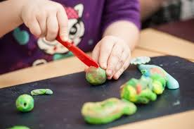
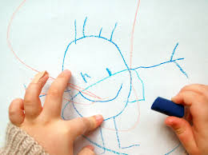
Playful Opener: Profiles in Playfulness
Represent your playful learner using something in your Play Kit.
Chat with the others in your small group while you work.
Why do you think this person embodies a playful mindset?
What did you learn working on this assignment? Was it playful learning for you?

Slide 5
Play
Access to spaces to play
Implicit bias
Opportunities to talk and play about inequity
Access to play-based curriculum
Notes:
Introduce the idea that access to time to play, supports for play, environments for play are not equitably distributed – some children have more access to play than others. Playful learning experiences in schools is also often unequal (e.g., children in better resourced schools or serving higher-income families are more likely to experience learning through play rather than rote learning)

Slide 6
Implicit Bias in preschool (Gilliam et al)
Notes:
Explain that implicit bias affects all of us and how we see children – can affect their experiences of playful learning (e.g., how surveilled/free they are during play) (share results from Gilliam et al. 2016 study of teachers’ implicit biases)

Slide 7
Do early educators expect boys, Blacks, and Black boys to misbehave?
“Our findings demonstrate that early education staff tend to observe more
closely Blacks, and especially Black boys when challenging behaviors are
expected. These findings are important to consider given that no behavioral challenges were present in the videos, suggesting, in part, that preschool teachers may hold differential expectations of challenging behaviors based on the race of the child. This is consistent with the robust literature that evidences disproportionate rates of disciplinary referrals and exclusionary practices for Black boys that are not better accounted for by other factors.”
(Gilliam et al. 2016, p.11)

Slide 8
What can we do to make our classrooms more playful and more just?
Draw on anti-bias, anti-racist frameworks for our work with children
Anti-Bias education
Culturally Sustaining Pedagogies
Know our learners
Funds of Knowledge
Listen and observe for opportunities to engage children
Use play as a way to surface, address, and counteract stereotypes, rather than reproduce them

Slide 9
Example: Using our Powers for Good: Considering Issues of Ownership, Power, and the Sharing of Community Resources
Eliot-Pearson Children’s School Kindergarten 2010-2011
(used with permission from Heidi Given)
Notes:
This is an example of young children directly addressing bias during play with their teachers in a preschool classroom. Could replace this with an example of older learners if preferred

Slide 10
You can go up any ramp, if you have a lot of money… People with a lot of money can go in anywhere they want.
--kindergartner
Notes:
Using our Powers for Good:
Considering Issues of Ownership, Power, and the Sharing of Community Resources
Eliot-Pearson Children’s School
Kindergarten
2010-2011
Quote from a kindergartner:
“You can go up any ramp, if you have a lot of money… People with a lot of money can go in anywhere they want.”
This first hint that children were thinking about issues of ownership, resources, and power inspired teachers to observe more closely, paying attention to the language and understandings which children were demonstration about social class, wealth and privilege. As kindergarteners worked through the typical social tasks of asserting power, negotiating inclusion and exclusion, and gaining and maintaining access to play, we noted that the children’s attempts to assert themselves often referenced possession (“I got it first.”), ownership (“That’s mine.”), status (“I am the boss.”), and cultural capital (“If you don’t know this movie, then you don’t know how to play.”).
II. Feelings
Initially surprised and intrigued, the teachers struggled with the connections we saw between children’s play and societal issues of colonization, exclusivity, and corporate hierarchies. Children’s accurate reflections of our capitalist society provided a lens into how they were constructing knowledge of social class concepts. As we decided to respond, teachers were excited and nervous about approaching a subject that continues to feel ‘taboo’, even in adult conversation. We wondered:
What role have we played in our classroom that is supporting and reinforcing the ideas of ownership as power?
How do our own class backgrounds effect our perceptions of our observations and how might they equip us, or not, to support the children as they expand their understanding of these ideas?

Slide 11
Notes:
The teachers wondered and worried about appropriate next steps, and the balance between providing room for children to develop their understandings through play and our role in redirecting that play and teaching social responsibility.
What they did:
At a meeting time in March the teacher Heidi launched a conversation by saying:
Now that the snow has melted I want us to talk about how we can use the bikes before we go outside. I’ve heard some of you say about rules:
I got that first so its mine and The person who has the thing first decides the rules for the thing. Do you like these as rules?
Chorus of nos.
Heidi: what rules do we want to have that would be fair?
Chrsiti: I think we should be sharing the bikes.
Chorus of me too
Heidi: Do you have some ideas to share

Slide 12
Notes:
Then this conversation took place after trying the children’s ideas:
Heidi: We’ve been using the shed sign up for a few weeks now. What do you think?
Tamaki: It works great.
Chorus of yeahs
Finn: People get to use the bike for a long time the way they want to.
Heidi: Have there been any problems?
Melody: Sometimes people just leave the bike and don’t go get the other person.
David: We can remind each other to go back to the list.

Slide 13
Notes:
Example of a profile in playfulness – Debbie was the director at Eliot-Pearson, where the above example took place
The slides that follow are Debbie’s and are shared with her permission

Slide 14
NOTE: This and the following slides with blue backgrounds are used with permission from Debbie LeeKeenan

Slide 16
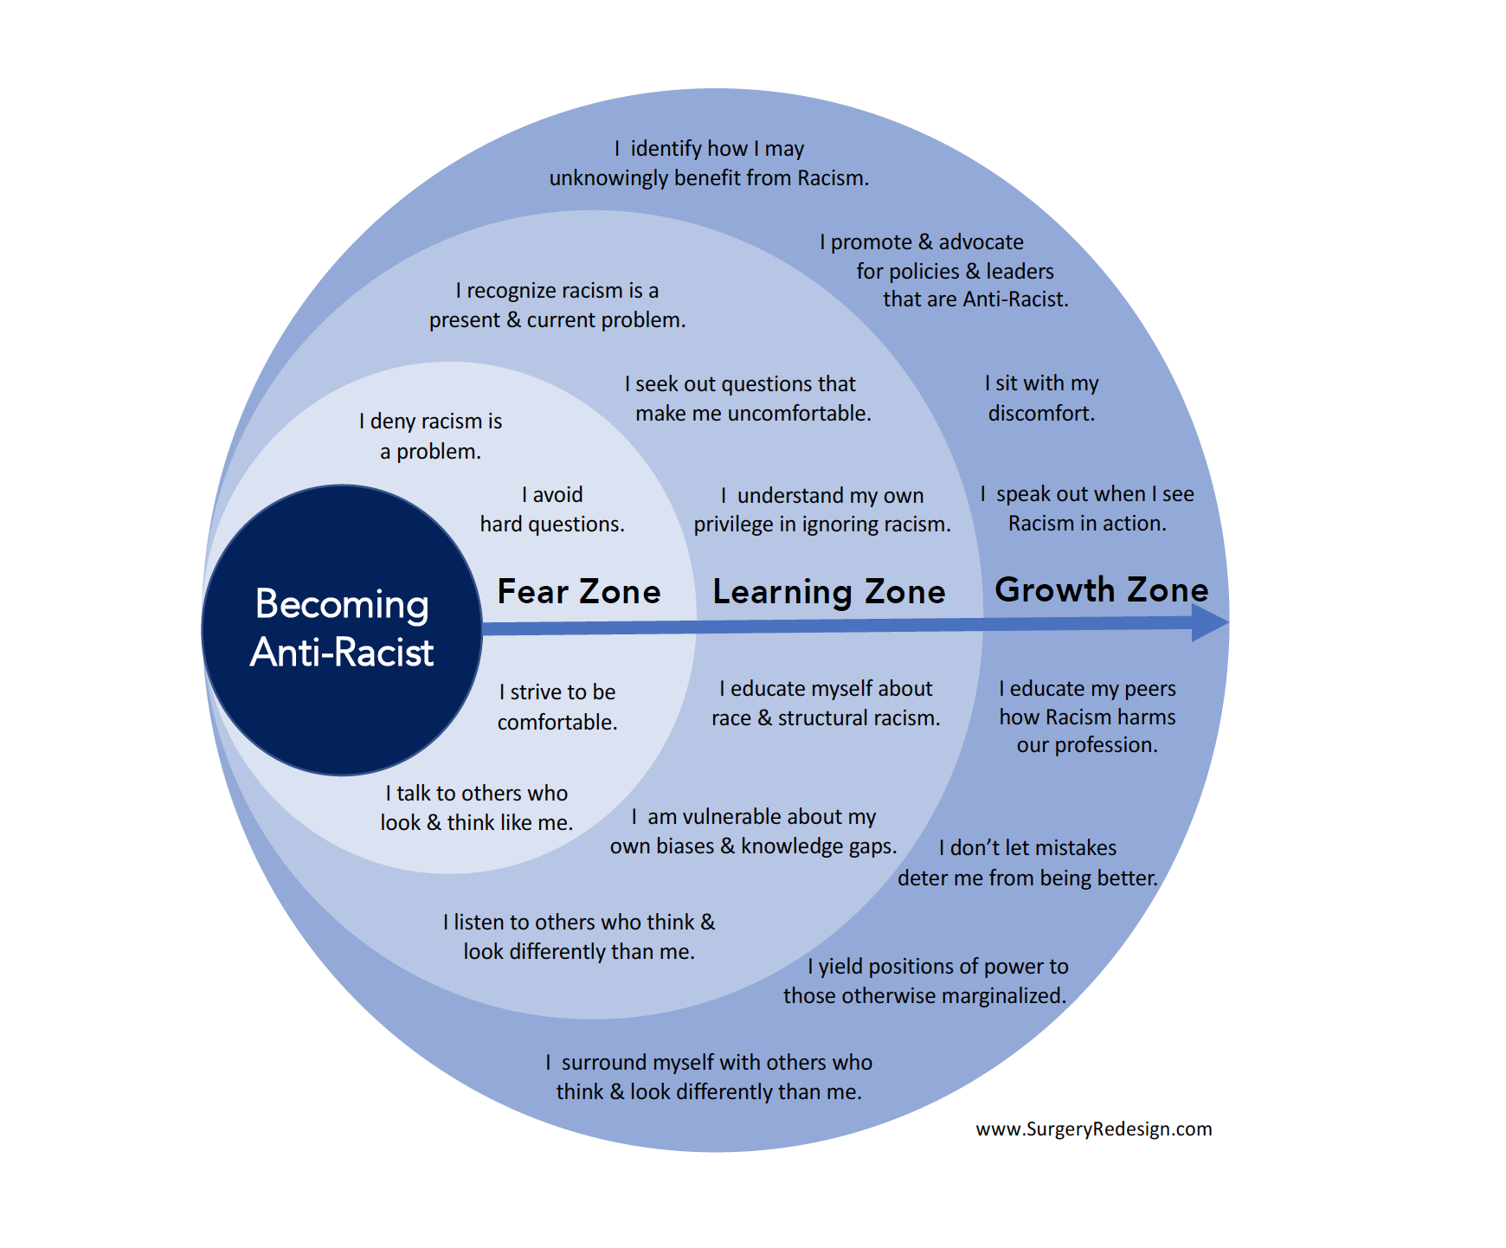

Slide 18
Notes:
This slide and the following are details of the four goals of anti-bias education, from the Derman-Sparks & Edwards book.

Slide 22
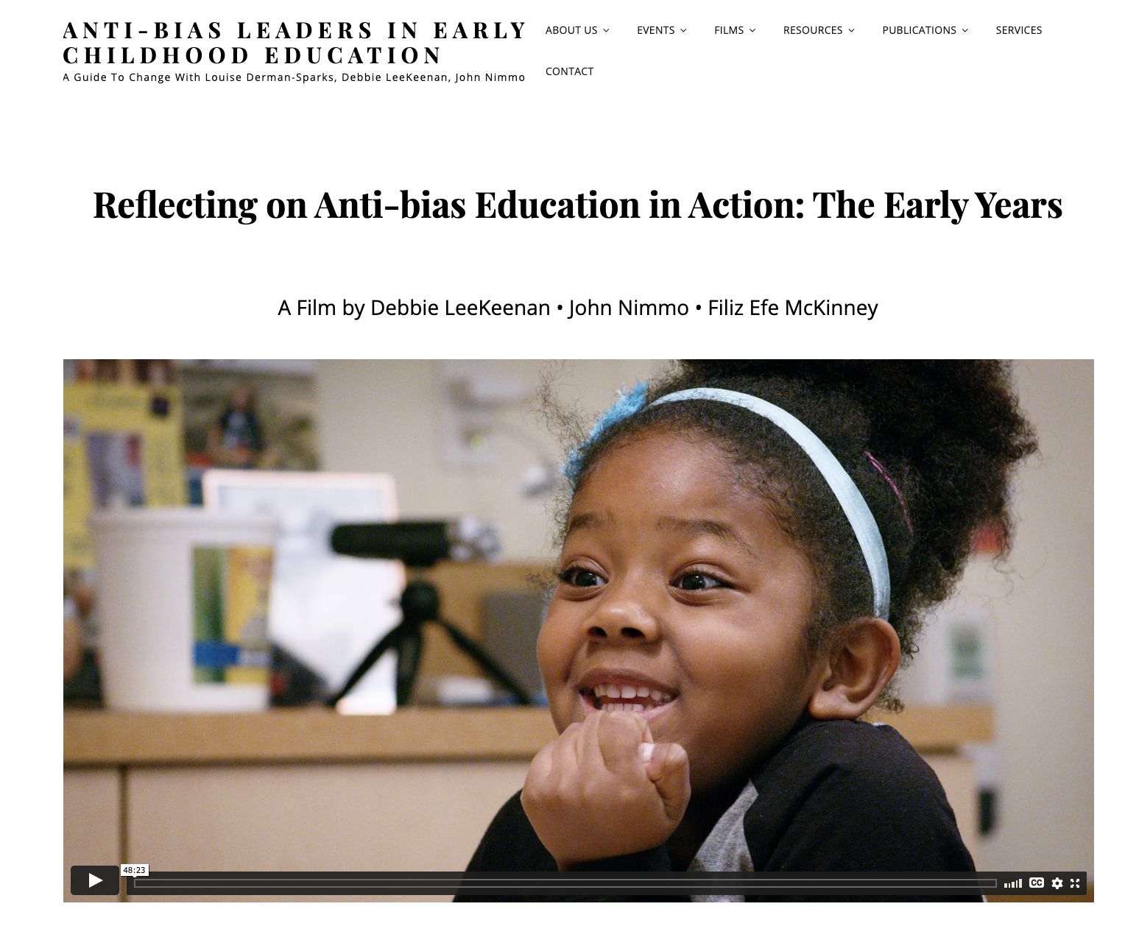
Want to learn more about anti-bias education? Watch the film here

Slide 23
Thought Museum
See activity card – add link here to Jamboard if remote, or instructions for physical activity if in-person

Slide 24
RECESS
Take a break!

Slide 25
What can we do to make our classrooms both playful and just?
Understand, acknowledge, and stay aware of our own implicit biases
Draw on anti-bias, anti-racist frameworks as we work with children
Anti-Bias education
Culturally Sustaining Pedagogies
Know our learners AND see families as partners
Funds of Knowledge
Listen and observe for opportunities to engage children
Use play as a way to surface, address, and counteract stereotypes, rather than reproduce them

Slide 30
Getting to know your learners
Depending on the age of the learners, here are some questions and conversation starters you might use:
Home language: What language(s) do you speak with your family and friends?
Cultural background: Where are you and your family from?
Family traditions and values: What traditions and values are important to your family? Do you have any special days or celebrations?
Friends and family members: Who is in your family? Who are your friends?
Family members’ occupations or skills: What does your [parent/ grandmother/ sister/ uncle…] do while you are at school?
Play activities (learner and family): What do you like to play? What do you like to do when you’re by yourself? With your friends? With your family?
Favorite games, sports, play themes, or hobbies: What are your favorite games? Sports? Hobbies? What do you like to do outside of school?
Favorite music, movies, or TV shows: What music do you like to listen or dance to? What movies or TV shows do you like to watch?
Household responsibilities (e.g., caregiving, chores, growing and preparing food): What do you do at home to help your family? Do you help take care of siblings or other children at home? Clean? Cook? Make repairs?
For conversations with families: What would you say are the strengths and interests of your child(ren)? What else do you think it is important to know about your child? What is important to know about your family?
Add, remove, or substitute other questions that are relevant to your context. We developed these questions by drawing on González, N., Moll, L. C., & Amanti, C. (Eds.). (2006). Funds of knowledge: Theorizing practices in households, communities, and classrooms. Routledge.
Notes:
This text is pulled from the PoP Tool ”Getting to Know your Learners”
In this activity, students will try out the tool with each other, and think about how they could use it as teachers to learn about their students’ funds of knowledge.

Slide 31
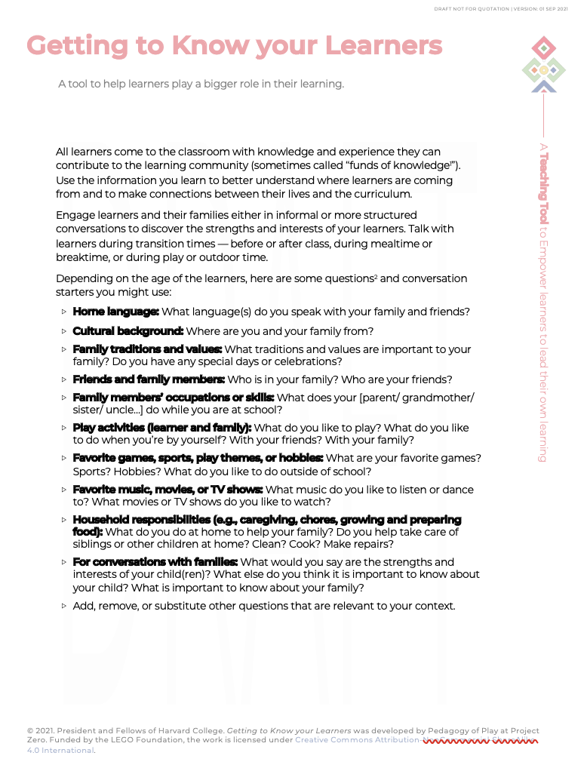
Try the “getting to know your learners” tool with each other
Discuss as a group – talk about the categories you want to share
Be ready to share out:
Something your group had in common
Something that was unique for each person in your group
How will you learn about the funds of knowledge of your learners for the Playful Participatory Research project?

Slide 32
“Because play is spontaneous, fluid, and infinitely malleable, it can accommodate many cultural themes. Moreover, it has the potential to break down the distinction between insiders and outsiders, to equalize relationships, and encourage children to risk playing new roles.” (Ramsey, 2015)
Notes:
Great quote to discuss – include this in the thought museum and also a good wrap-up option

Slide 33
I used to think… Now I think….

